Slide 1

AneX - Prototype Your Personalized Smartphone Advisor

Slide 2
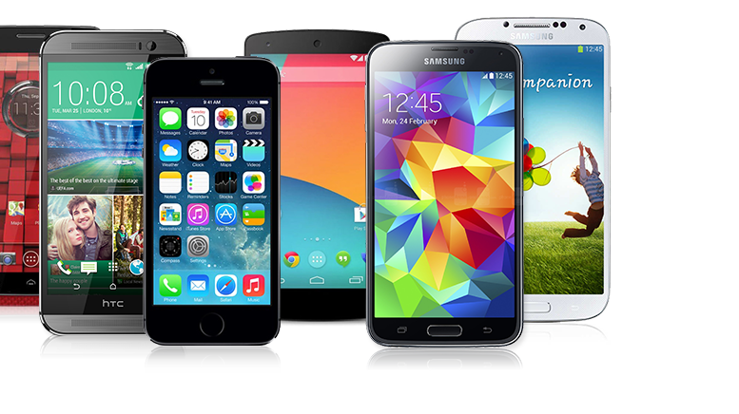

Problem Statement:
Lots of Smartphones
Similar functionality in all smartphones
Some features can make it or break it for you
No interest/ time to research the most suitable phone

Slide 3

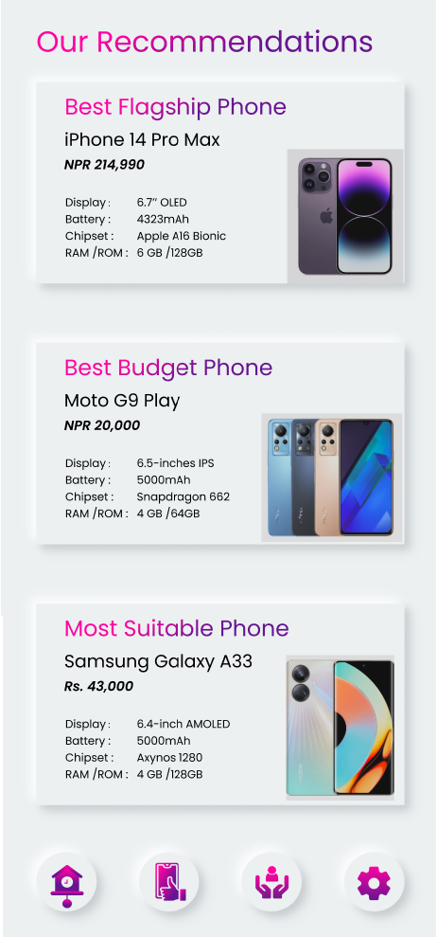
Solution – AneX

Slide 4

How our app works
User answers the given questions
Recommendation engine filters and refines the dataset based on choices
Top Recommendations are displayed
User goes to our website

Slide 5

Background Working
Smartphone dataset downloaded from Kaggle
The recommendation engine processes the dataset based on user requirments
Displaying using Flask & React

Slide 6

Inside Our Recommendation Engine
Handling missing values (NaN) by forward filling (ffill) and specific value replacement for certain columns like 'extended_upto' and 'fast_charging’.
Converting resolution strings into numerical 'pixels' values using a custom evaluation function (evaluate_resolution).
Categorizing smartphones into different categories (“Flagship”, ”Mid-range”, and ”Average”)
Calculating ratings for camera quality (categorize_camera), and performance (categorize_performance),
Calculating certain percentiles for getting the estimate of all smartphones (percentile function)
Adjusting ratings and recommendations dynamically based on user responses and predefined thresholds Ex. If user needs a better camera, the phones with better camera_ratings are given priority, etc
Final Recommendation is exported as csv and also displayed.

Slide 7


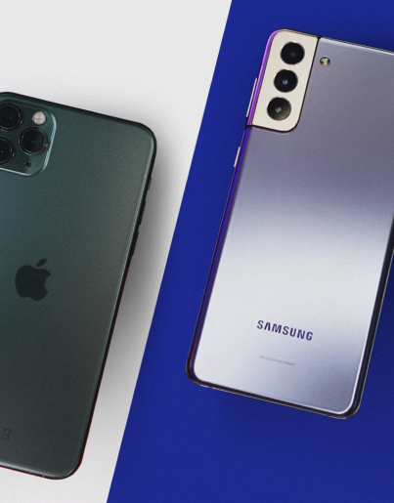
Feasibility and Scalability:
23M+ smartphones users in Nepal
22M+ people with internet access
Every 3.25 years a person buys a new phone
35 billion+ in smartphones import (2023)
Access to smartphones and trend of buying the latest and best only growing

Slide 8

Additional Improvements:
Add other specifications such as :
Display Panel Type
Price for each storage model
Display Brightness
Speaker Ratings
Wireless Charging support
Year or Release
Add Nepali Prices
Improve the UX/UI further
Fine-tuning of recommendation engine

Slide 9
Thank You
Thank you for considering our project

